Slide 1
Essential Question
What events from world history led to the settling of America?
Why You Should Care
This nation (where you live) had to start somewhere. Imagine watching a movie without watching the first 20 minutes. It wouldn’t make sense!
Notes:
https://www.youtube.com/watch?v=ved5evZ8M2g

Slide 2
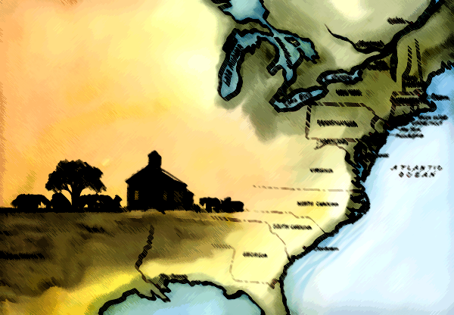
How Did We Get Here?
The Rise of the 13 Colonies

Slide 3
Step 1: The Discovery

Slide 4
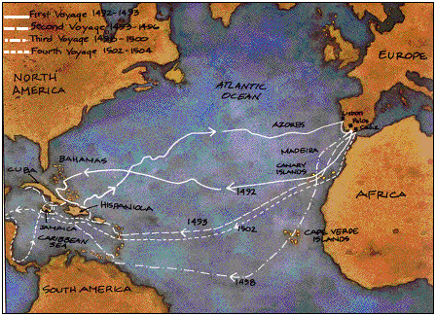
Columbus
Columbus’ voyage in 1492 marked the European discovery of America.
He went partly to spread Catholicism…
But mostly to find resources like spices.
Instead found gold (and plenty of other shiny things) that greatly interested the Europeans.

Slide 5
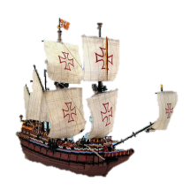
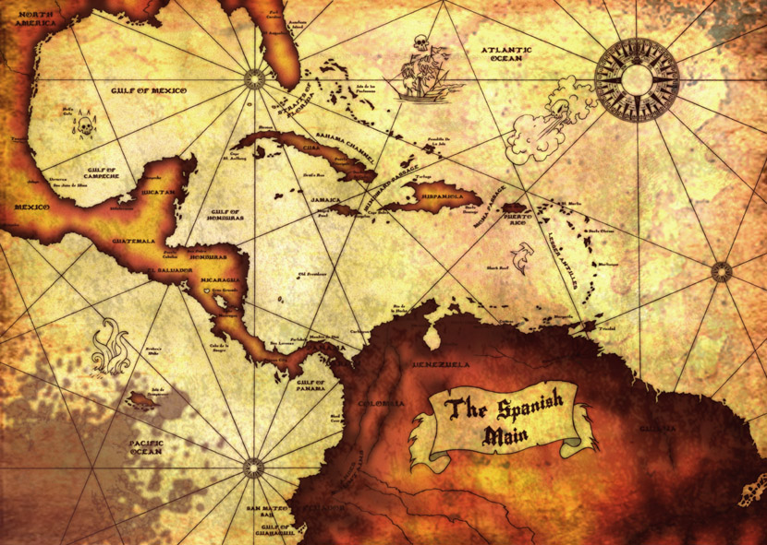
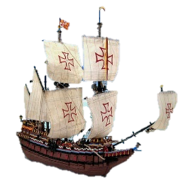
To Spain

Slide 6
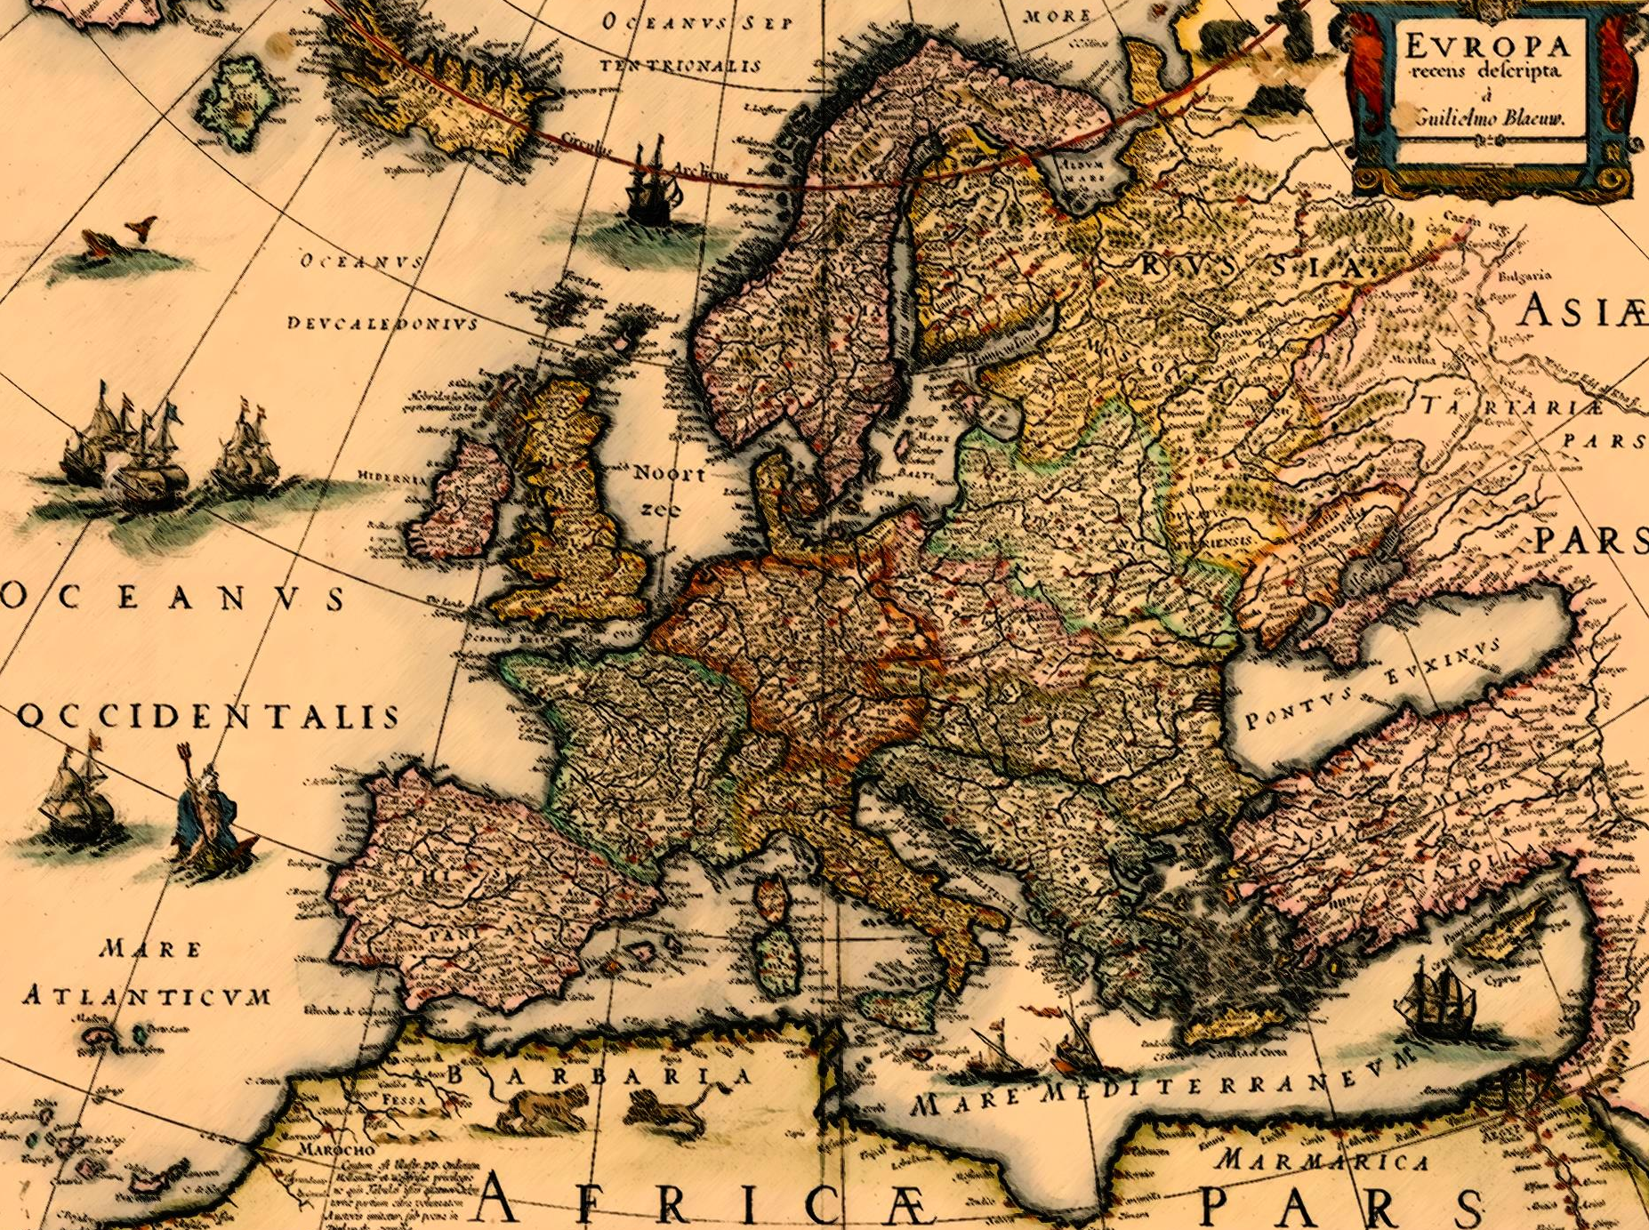
Excuse us old chaps. Might we join in your game of riches?
=(
England
Spain
No, you Protestant perros. If you try, we’ll use our riches to destroy you.
Notes:
Euro map

Slide 7
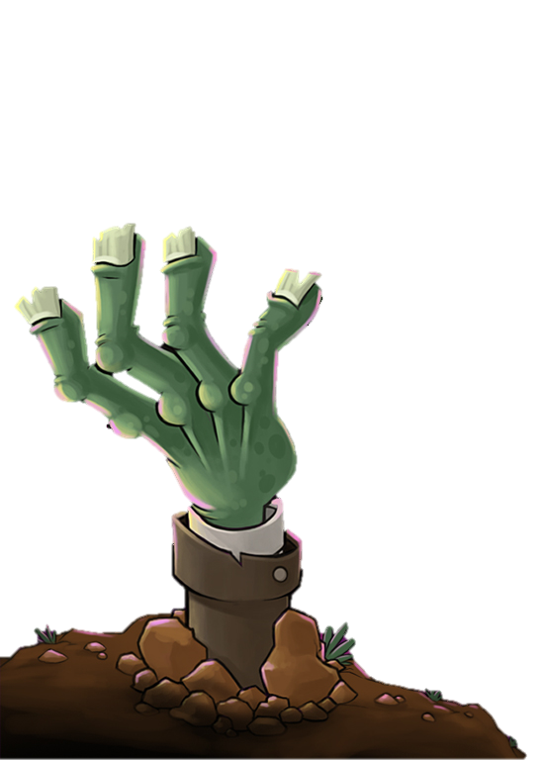
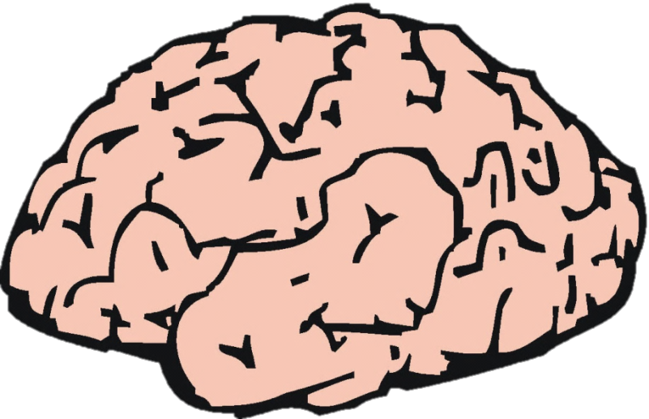
Brain
Snack
.
.
.
.

Slide 8
PROBLEM SOLVERZ

Slide 9
Spain has a massive navy.
They have claimed the entire area around the Caribbean and South America.
They are using resources from Americas to build even more.
England wants to get resources too.
Solve England’s problem!

Slide 10
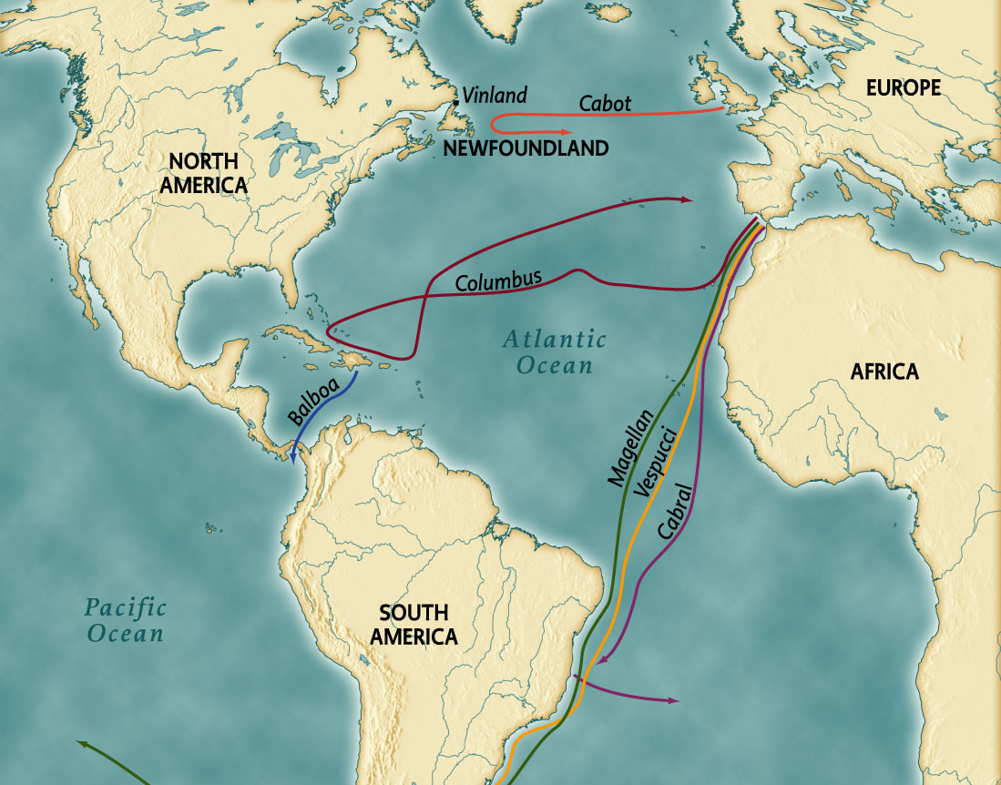
England
Spain

Slide 11
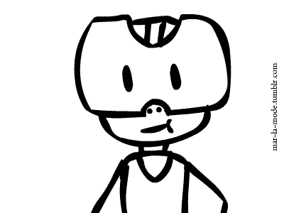

Slide 12
England vs. Spain
Spain claimed the entire “New World” since they landed there first.
The riches they gained allowed them to become even stronger and gain even more riches and become even stronger and gain more riches and… well you get it.
So, England (and Holland) explored and settled further north where the Spanish influence (and navy) wasn’t so strong.

Slide 13
Step 2: The Ideas

Slide 14
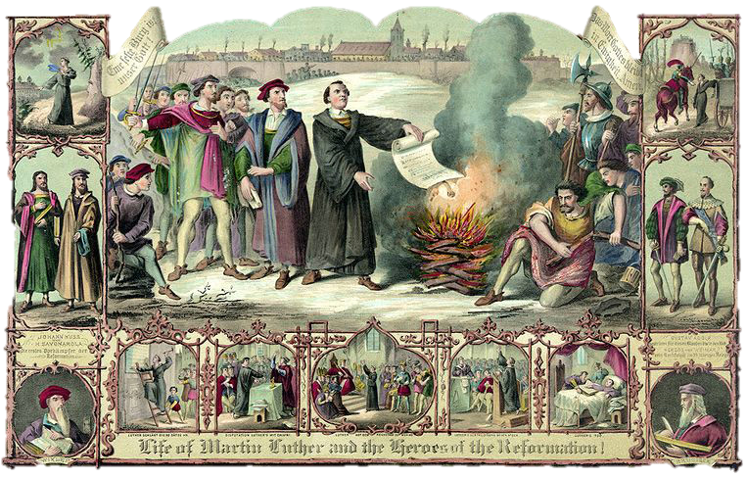
Step 1: The Idea
This is what I say to the pope’s law! I obey only God.
Self-governance from reformation
Hmm… wonder if I have to obey the king.
Hey, good point. We shouldn’t have to follow any man right?

Slide 15
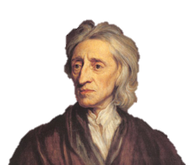
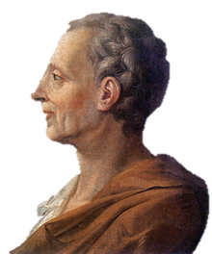
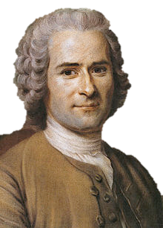
“To understand political power aright, and derive it from its original, we must consider what estate all men are naturally in, and that is, a state of perfect freedom…” -John Locke
“In the state of nature all men are born in equal, but it can not continue. The Society makes them lose this, and they recover it only by the laws.” -Montesquieu
“To renounce liberty is to renounce being a man, to surrender the rights of humanity and even its duties.” -Rousseau
“The right of nature... is the liberty each man hath to use his own power, as he will himself, for the preservation of his own nature; that is to say, of his own life.”
– Thomas Hobbes

Slide 16
Brain
Snack
.
.
.
.

Slide 17
Liberty
Define (v)
provide a definition for…
Notes:
Speculate on the meaning of a word
Example: Liberty

Slide 18
Reformation and Enlightenment
The Reformation gave people the idea that no man is above another in relation to God.
This led to the idea that the same was true in government (since government is from God.)
Thinkers like Locke and Hobbes began to write and discuss the basic ideas of liberty that eventually became the ideals of America.

Slide 19
Step 3: The Settlers

Slide 20
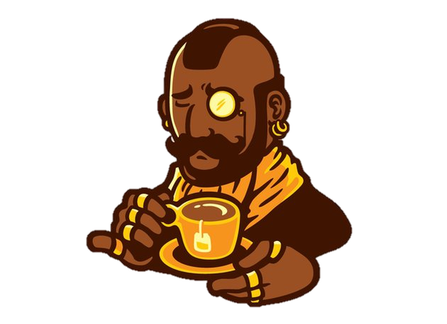
Roanoke and Jamestown
These settlers came mostly for economic reasons (like promises of gold).
Most did not expect to have to work. They would just show up, find some gold sitting around and be rich.
Instead, the work was intense, food was scarce, danger was high and an incredible number of them died.

Slide 21
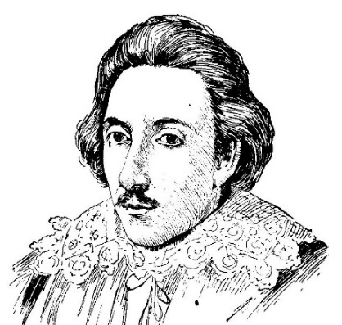
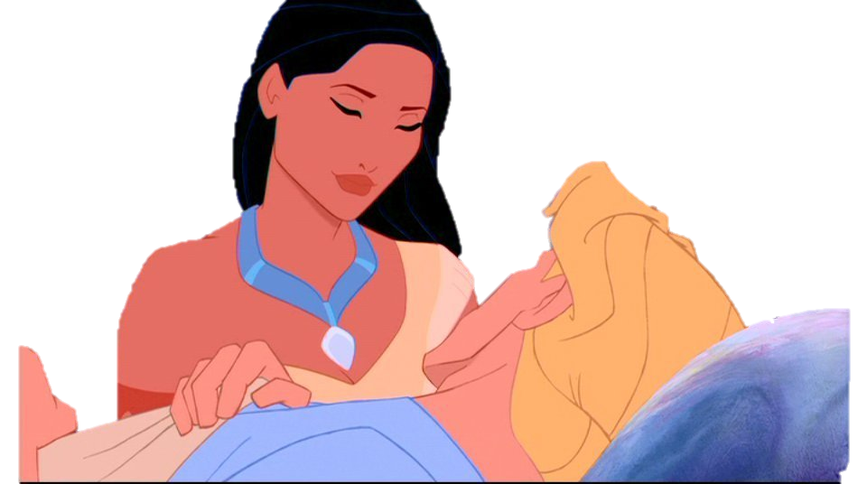
Roanoke and Jamestown
“There were never Englishmen left in a foreign country in such misery… Our food was but a small can of barley, sod in water, for five men a day… our men night and day groaning in every corner of the fort most pitiful to hear… some departing out of the world, many times three or four in a night; in the morning their bodies trailed out of their cabins like dogs to be buried.”
– Captain George Percy
In Roanoke supplies ran out so their captain returned to England for more. When he returned – the colony was gone.
In Jamestown they worked with the local Powhatan natives (for awhile…)
Later went through “the starving time” where 440 of the 500 settlers died.
Starving
Powhatan
Not historical

Slide 22
Plymouth
"We shall be as a city upon a hill, the eyes of all people are upon us.“
-John Winthrop
"You are the light of the world. A city that is set on a hill cannot be hidden.“
-Jesus

Slide 23
Pilgrims and Puritans
These settlers came mostly for religious reasons (they were not welcome in England.)
They expected to work and brought along entire families with them with plans to stay for good.
Still, the work was intense, food was scarce, danger was high and an incredible number of them died.

Slide 24
And then…
Despite the rough start the settlements began to grow.
America provided land, resources and freedom unlike anywhere in Europe.
The King saw value in these colonies and soon sponsored even more.
Before too long there were 13 colonies and a truly new world.

